Slide 1



Crypto 101
Oded Vanunu
Dikla Barda
Roman Zaikin
Liad Mizrachi

Slide 2


What is Bitcoin?
Bitcoin (₿) is a decentralized digital currency, without a central bank or single administrator, that can be sent from user to user on the peer-to-peer bitcoin network without the need for intermediaries.
Transactions are verified by network nodes through cryptography and recorded in a public distributed ledger called a blockchain.
research.checkpoint.com
Notes:
https://www.blockchain.com/btc/unconfirmed-transactions

Slide 3
How Bitcoin works?
HASH function, SHA-256 is a cryptographic hash function that outputs a value that is 256 bits long.
https://andersbrownworth.com/blockchain/hash
research.checkpoint.com

Slide 4
How Bitcoin works?
Block, Blocks are files where data related to the Bitcoin network are permanently recorded. A block records some or all of the most recent Bitcoin transactions that have not yet entered any prior blocks. Thus, a block is like a page of a ledger or record book.
https://andersbrownworth.com/blockchain/block
research.checkpoint.com

Slide 5
How Bitcoin works?
A consensus algorithm is a procedure through which all the peers of the Blockchain network reach a common agreement about the present state of the distributed ledger.
Proof of Work (PoW): This consensus algorithm is used to select a miner for the next block generation. Bitcoin uses this PoW consensus algorithm. The central idea behind this algorithm is to solve a complex mathematical puzzle and easily give out a solution.
Proof of Stake (PoS), Proof of Burn (PoB), Proof of Capacity, Proof of Elapsed Time
research.checkpoint.com
Notes:
https://www.geeksforgeeks.org/consensus-algorithms-in-blockchain/

Slide 6
How Bitcoin works?
Mining, Bitcoin mining is the computationally-heavy process of computers validating bitcoin's network of transactions.
While the cryptocurrency's supply is limited at 21 million coins, it distributes a small part of that supply to miners for contributing computer power, thereby securing the network.
https://blockstream.info/
research.checkpoint.com

Slide 7
How Bitcoin works?
Mining, Bitcoin mining is the computationally-heavy process of computers validating bitcoin's network of transactions.
While the cryptocurrency's supply is limited at 21 million coins, it distributes a small part of that supply to miners for contributing computer power, thereby securing the network.
Unconfirmed Transactions
(mempool)
???
7532
1234
4321
???
research.checkpoint.com
Notes:
https://explorer.blocknative.com/?v=1.30.12&0=ethereum&1=main

Slide 8
How Bitcoin works?
4-6 Confirmations, Proof of Work as a security.
7532
1234
4321
3212
7664
????
7532
1234
4321
3212
7664
????
Unconfirmed Transactions
research.checkpoint.com

Slide 9
How Bitcoin works?
Distributed network, A distributed ledger is a database that is consensually shared and synchronized across multiple sites, accessible by multiple people. ... Blockchain is a type of distributed ledger used by bitcoin.
https://andersbrownworth.com/blockchain/distributed
research.checkpoint.com

Slide 10
How Bitcoin works?
Token, Every transaction is recorded on the distributed ledger technology. Bitcoin is a digital currency and its operate with no central authority or banks; managing transactions are carried out collectively by the network.
https://andersbrownworth.com/blockchain/token
research.checkpoint.com

Slide 11
What is Bitcoin Goal?
Bitcoin's current goal is to be a store of value as well as a payment system, there is nothing to say that Bitcoin could not be used in such a way in the future, though consensus would need to be reached to add these systems to Bitcoin.
New goal, taproot update 14 November 2021 add smart contract to Bitcoin.
research.checkpoint.com

Slide 12
Smart Contract and Ethereum?
Ethereum (2013) is a decentralized, open-source blockchain with smart contract functionality. Ether is the native cryptocurrency of the platform.
A smart contract is a computer program or a transaction protocol which is intended to automatically execute, control or document legally relevant events and actions according to the terms of a contract or an agreement.
research.checkpoint.com

Slide 13
Smart Contract EVM
Ethereum Virtual Machine (EVM) is a computation engine which acts like a decentralized computer that has millions of executable projects. It acts as the virtual machine which is the bedrock of Ethereum's entire operating structure.
research.checkpoint.com

Slide 14
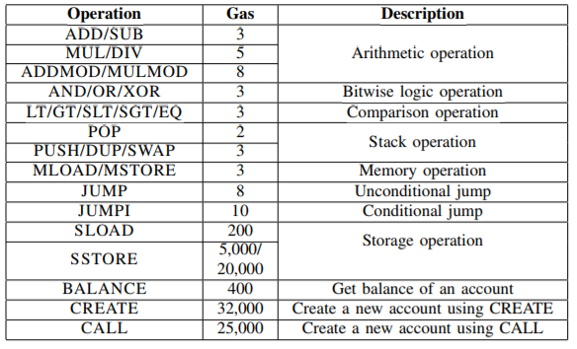
What is innovative about that?
What Is Gas Price? A general reference for approximate transaction fees on the Ethereum blockchain, gas price refers to the amount of ETH (in a small unit called gwei) that must be paid to miners for processing transactions on the network.
research.checkpoint.com

Slide 15
What is innovative about that?
Immutable open source code.
Payable functions.
Transparent backend functions.
Decentralized Code (Lambda Like).
All the Transaction are Transparent.
https://etherscan.io/address/0x3845badAde8e6dFF049820680d1F14bD3903a5d0#code
research.checkpoint.com

